Slide 1
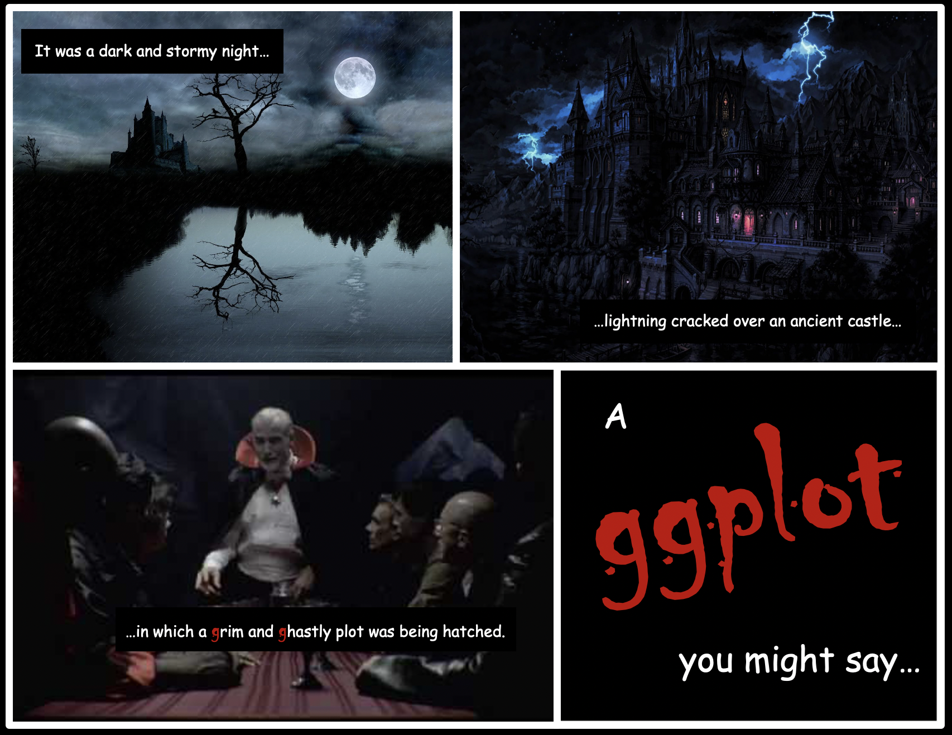
Halloween ggplot workshop! 🎃
Want to learn how to make compelling data visualizations with the powerful and flexible ggplot2 package in R?
Want an excuse to dress up for Halloween even if you're not leaving the house?
If your answer to one or both of those questions is "YES!" come join us for a very spooooooky workshop.
Friday, Oct 30, 12:00–2:00 p.m. ET
Register here.

